Slide 1
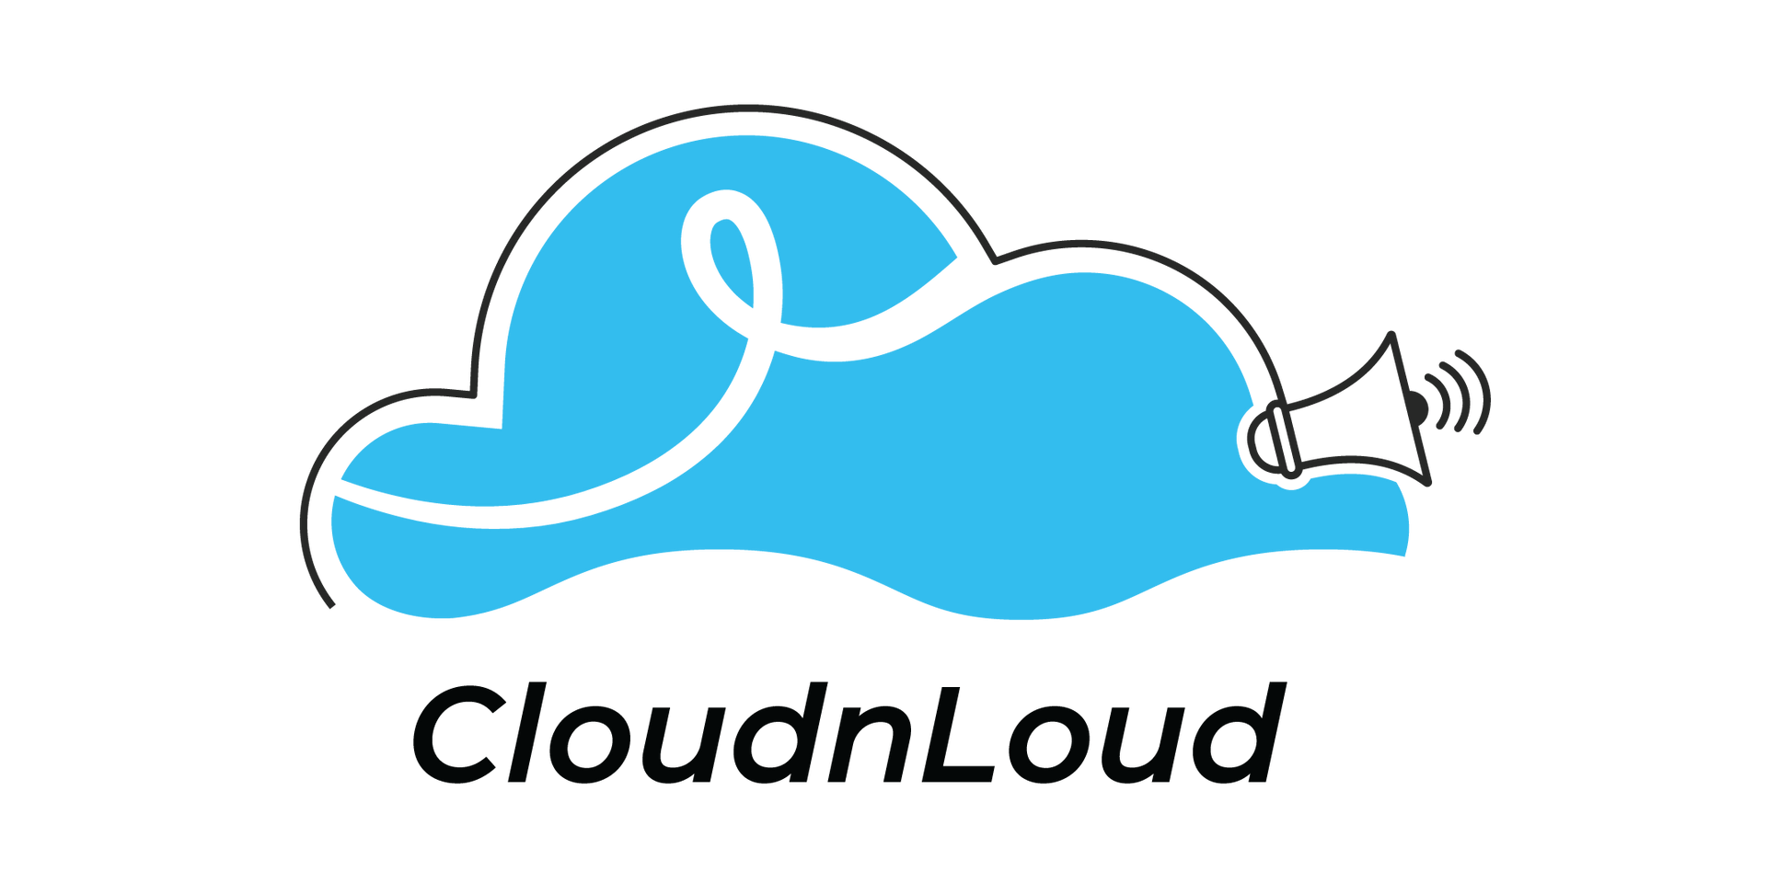

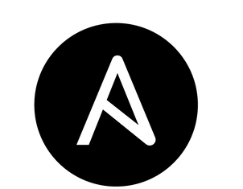
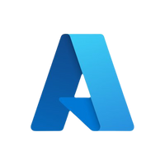

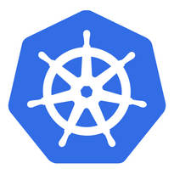
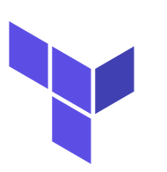
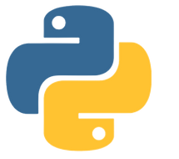

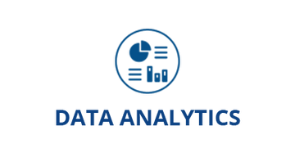




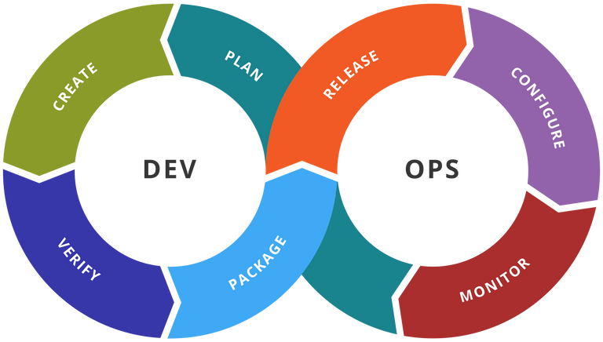

Community

Slide 2

About Us
Cloudnloud was started 11 years back with an intention of up-skilling and up-scaling all our members on the technical front with the niche topics around Cloud, DevOps,Data, AI and much More.
Cloudnloud was started by Vijayabalan Balakrishnan Who is a cancer survivor from Jan 2011. He is helping the Tech community and Cancer Children for the past 2 decades to loud from their own confidence in the IT industry. Officially it has become a registered Pvt Ltd on Jan-2015 to help and support cancer children from its revenue. Today Cloudnloud is living that dream with 6000 plus cancer children's survivors across the Globe.
WHO WE ARE
Community
02

Slide 3

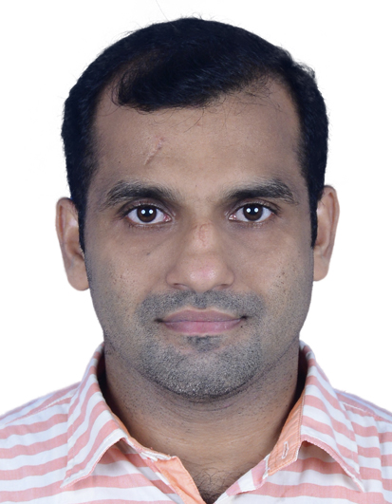

Sibin John
[Your Good Photo]
An expereinced SRE/DevOps with knowledge in latest infrastructure concepts and tools.
AWS, Kubernetes, Terraform, Ansible, Linux, Observability and logging tools like Datadog, ELK

Slide 4


A java application in AWS EKS

Slide 5

1
Introduction to the Session
Today's
Agenda
2
Team Check-in and Icebreaker
3
Stop Start Continue
4
Summary and Action Items
Community

Slide 6
This session is going to discuss about infrastructure designed to migrate and run a stateful java application from EC2 to EKS.
Community

Slide 7
Why we need an alternative for EC2 based infra?
* we need more time for administration and maintaining the applicationin EC2 nodes
* startup script creating problems sometime * wastage of resources when application is ideal
Community

Slide 8
What is the application and its business case?
IOT based E-commerce project
* should be performance optimized and highly available
* containerized application to control resource usage
Community

Slide 9
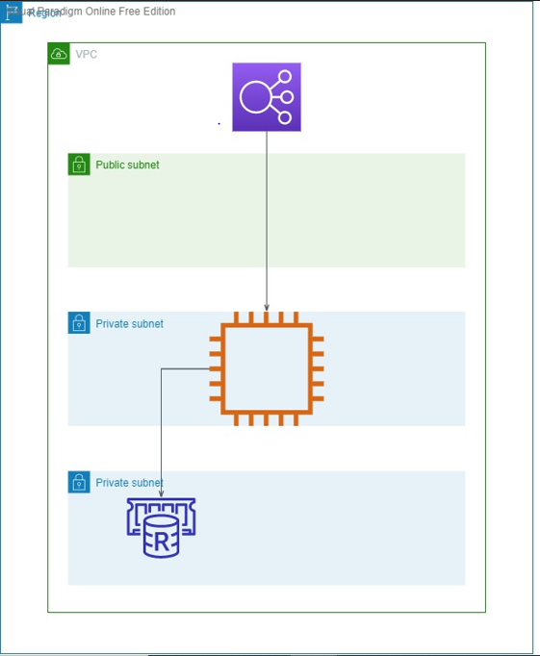
Current system architecture:
Community

Slide 10
Dockerize the java application and deploy into kubernetes cluster based on aws eks. This will give us below advantages:
* Reduce over resource consumption and thus the ec2 instance sizes of eks.
* More control on scalability
* High availability as an inbuilt feature since kubernetes pods will get recreate in case of failures
* easy to update patches and application packages
* Enhancements using CI/CD and Gitops and log management
* Less headache for maintaining the application
Community

Slide 11
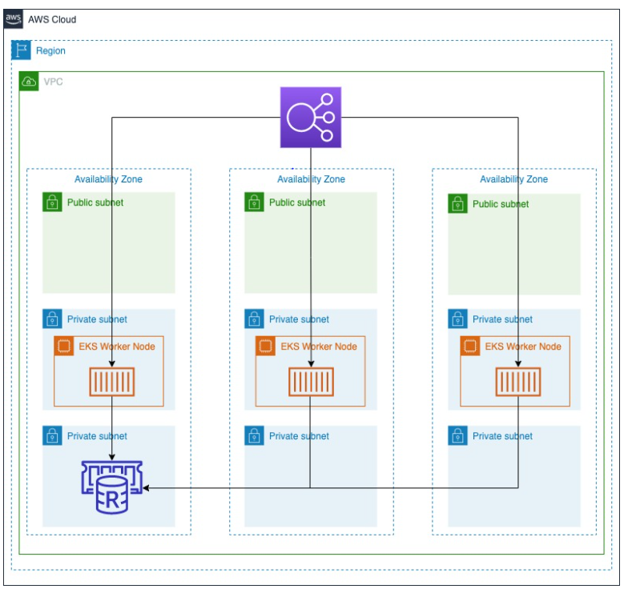
Proposed architecture:
Community

Slide 12
Advantages:
* Horizontal auto scaling will help to handle the peak time computing load.
* State maintaining using Elasticache redis will reduce the session loading time.
* The containerized architecture will help us to improve the application stability.
* The subnet segregation of private and public subnets will give more control on security.
Community

Slide 13











Community
Connect Us to Loud better
cloudnloud
Join Discord Channel
cloudnloud.com
info@cloudnloud.com

